Slide 1
5G TECHNOLOGY
By
CHANDRAKANT SM
HUBLI KTC

Slide 2
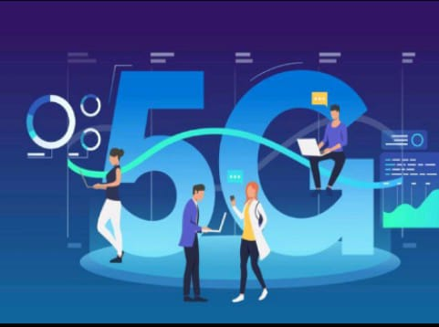
What is 5G Technology?
5G is the 5th gen mobile network. Its a new global
wireless standard after 1G, 2G,3G,4G networks.
5G is meant to deliver higher multi-gbps peak
data speeds,
ultra low latency, more reliability massive network
capacity, increased availability .
5G enables a new kind of network, designed to connect
virtually everyone and everything including machines
and objects , and devices

Slide 3
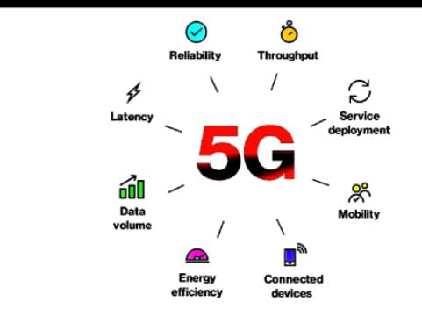
Why 5G Technology?
5g is faster than 4g: Peak spead is 20kbps
5g supports more traffic:100 times more traffic than 4g
5g has lower latency than 4g: Down to 1ms from 10ms

Slide 4
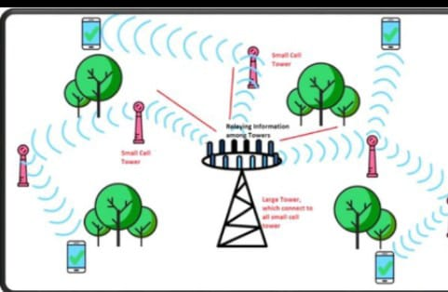
How 5G Technology works?
5G operates on the same way as other networks,
but makes use of higher radio frequencies .
To avoid the problems of large distance and blocked by
physical objects,5G makes use of multiple input and
output antennas. It also makes use of smaller
transmitters placed on buildings and street furnitures.

Slide 5
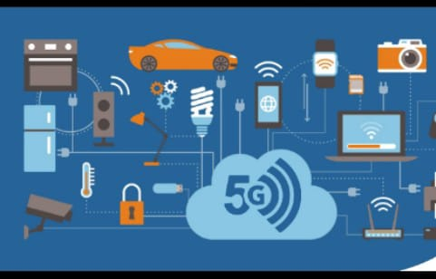
Where 5G is being used?
5G is used across three main types of connected services,
Enhanced mobile broadband.
Mission critical communications.
Massive IoT

Slide 6
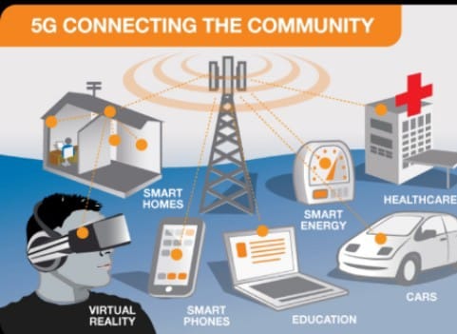
How 5G will affect me?
It can bring big changes in areas of virtual reality ,
the IoT, and Artificial Intelligence.
Near instant access to cloud services
multiplayer cloud gaming,
shopping with augmented reality,
real time video translation and collaboration.

Slide 7
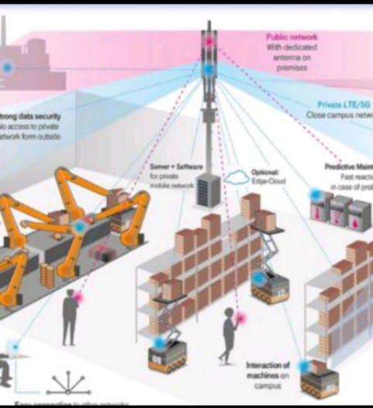
How and when will 5G
affect global economy?
Its driving global economic growth.
22.8 million new jobs are being created.
$265 billion annual global CAPEX and R&D annually
for next 15 years. Likely to see its full impact by 2035 ,
supporting $13 trillion of good and services.

Slide 8
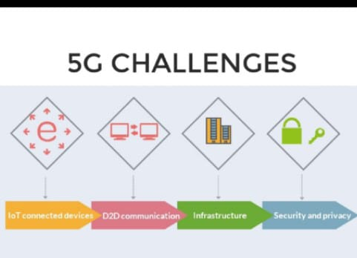
What are the challenges in
implementing 5G technology?
Mobile devices at user end need to be upgraded.
Managing expenses of 5G network deployment
Security and privacy concerns.
Approach for 5G network deployment.
Frequency band and spectrum availability.

Slide 9
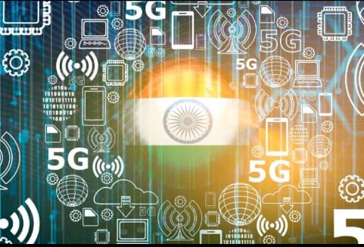
India and 5G technology.
Launched on 1st Oct. 2022 by
Hon PM Shri Narendra Modi.
India is leading the race to 5G technology and India's
technology is much sought after in the world.
Leading Indian players are, Reliance, bharti airtel,
Vodafone India.

Slide 10
Thank you

